Slide 1
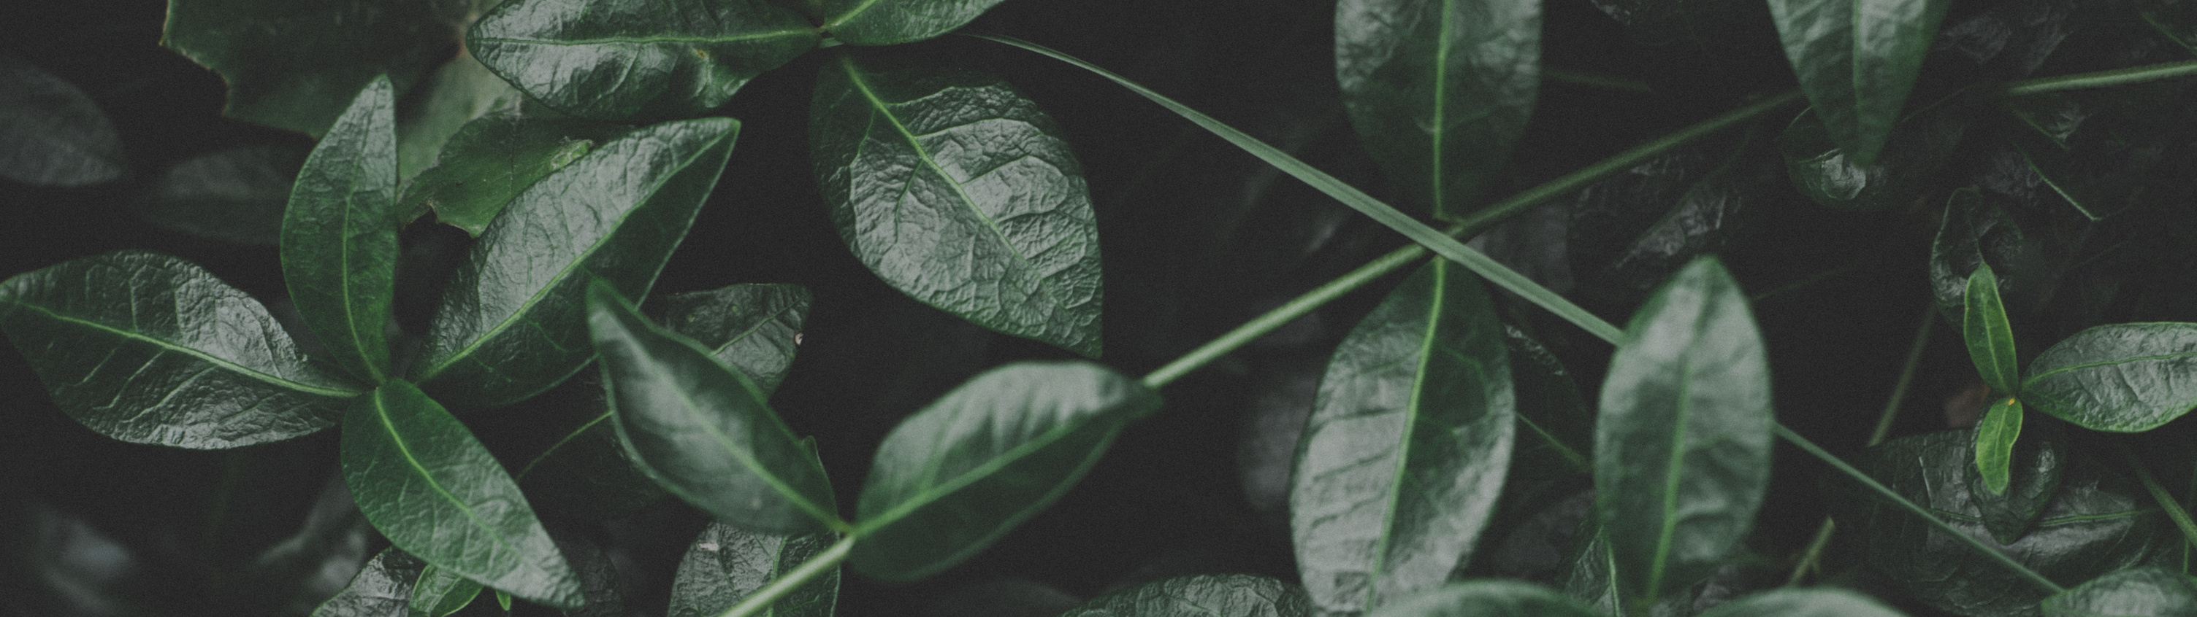

WE PLANT WE CARE
A step towards saving the future...

Slide 2
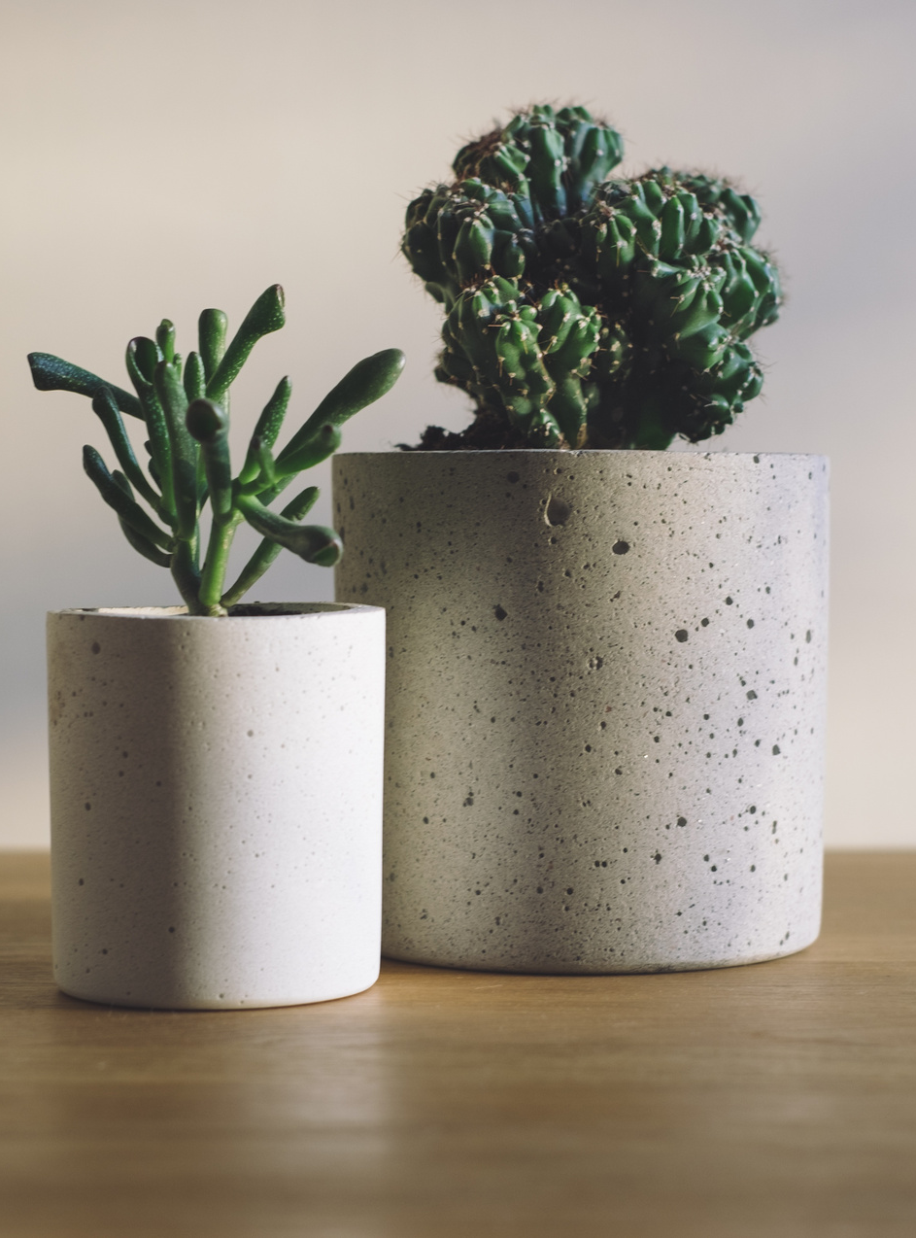
Introduction
So our aim is to basically target and save small plants so that they can grow. Every many saplings are planted but only few of them survive due to lack of care, but not any more. We have come up with an solution to this issue.

Slide 3
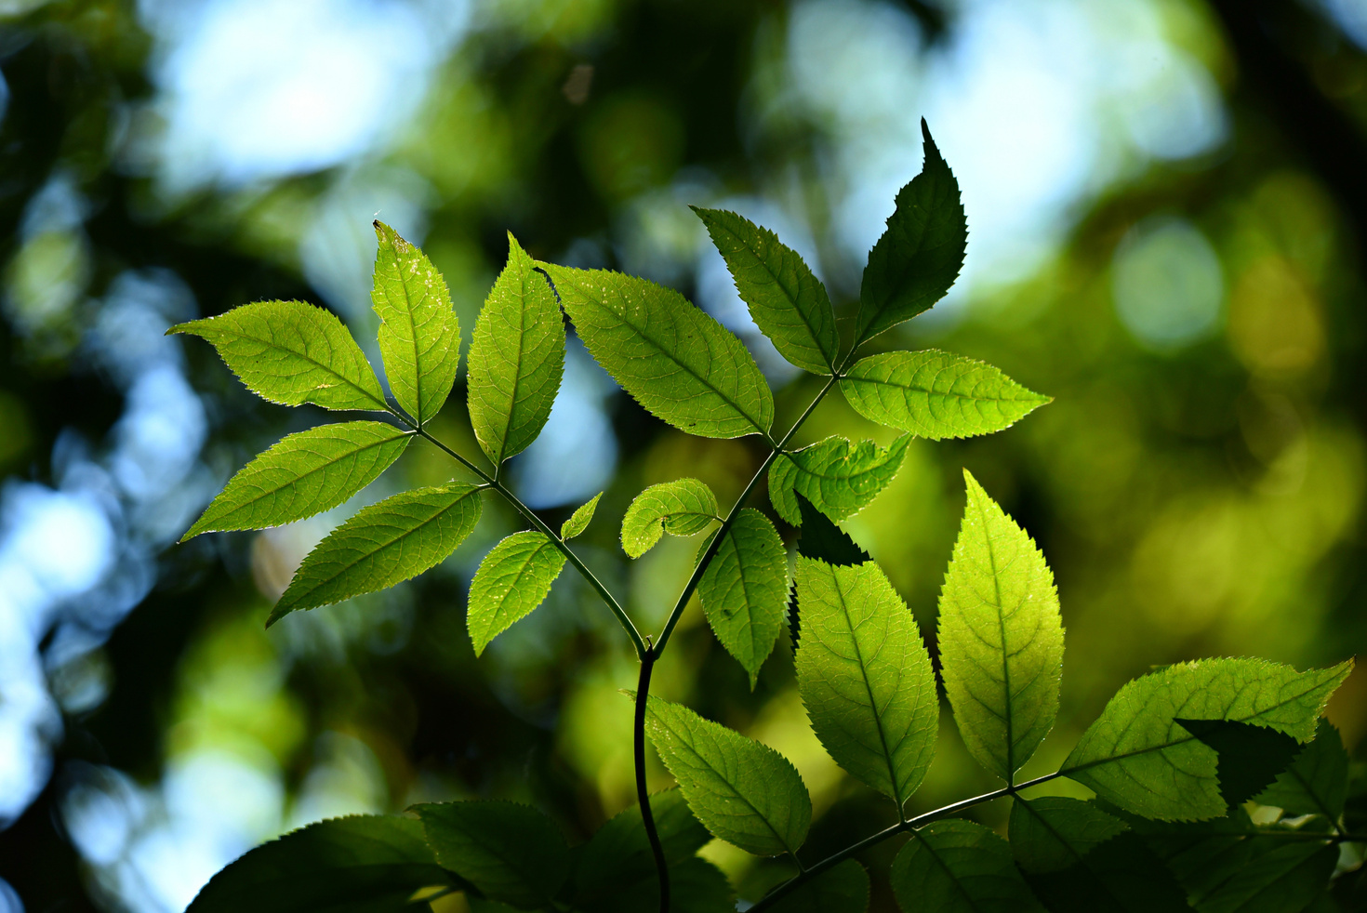
01.
Forest department will hire some caretakers to take care of plants. Caretakers will be using a application made by us which will assign him his daily work
Plant A Green Tree And Live Younger
02.
Caretaker's job will be to take care of sapling, check soil and sapling's health status and update us, and we will share that data in our public website.
03.
Title
You can also have a plant of your own. We will share your plants detail with you. Just visit our website, contribute a small amount and your plant will be planted and you will get a unique plant ID
to keep track.

Slide 4
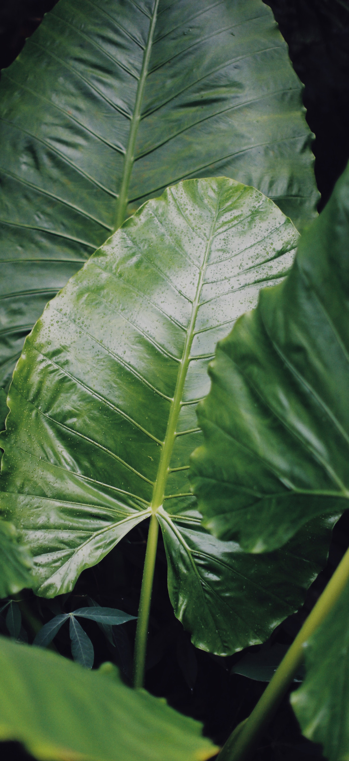
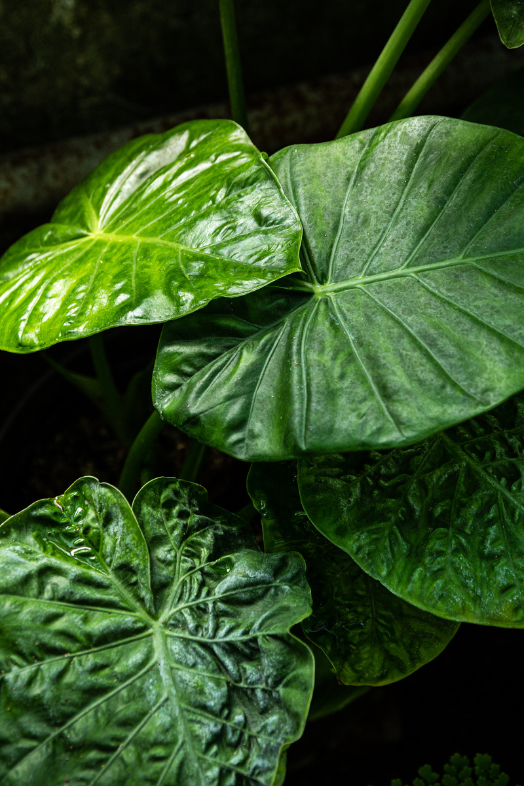
Short text and
image slide
We are using AI to detect plant's health care to achieve minimal human effort. So basically AI will need a image which will be clicked by the caretaker, Ai will detect the problem with sapling(if any) and will guide the caretaker accordingly.
Every day taking images of every plants is not possible. To avoid this caretaker's app will tell the caretaker to take images of the plant asked by our algorithm. Every plant has a unique ID which given to them while planting them. Our algorithm will randomly give any plant's ID and the caretaker will have to upload image of that plant.

Slide 5

Thank You

